Slide 1

Adventure Works- Manufacturing Analytics
Group Members: Date: 24/12/22
Amey Anant Kumbhar –Excel
Pushkar Umakant Angal- SQL-TASK 1
Vinayak Bhausaheb Raskar - SQL Task 2
Ajay Shahaji Nimbalkar - Power BI (data model and Dax)
P Guru Prashanth - Power BI charts and dashboard.
Aishwarya Kishor Patil – Tableau
Guide: Mr.. Arif Sir

Slide 2
What we do?
Adventure Works Cycles, the company on which the Adventure Works sample databases are based, is a large, multinational manufacturing company. The company manufactures and sells metal and composite bicycles to North American, European and Asian commercial markets. While its base operation is in Bothell, Washington with 290 employees, several regional sales teams are located throughout their market base.
In 2000s, Adventure Works Cycles bought a small manufacturing plant in Mexico. Which manufactures several critical subcomponents for the Adventure Works Cycles product line. These subcomponents are shipped to the Bothell location for final product assembly.

Slide 3
What do we Expect?
Adventure Works Cycles is looking to broaden its market share by targeting their sales to their best customers, extending their product availability through an external Web site, and reducing their cost of sales through lower production costs.

Slide 4
Excel Dashboard: by Amey kumbhar
Functions used in Excel-
LookUp Function
Date, Month, Year functions
Calculated Profits
Pivot Table
Bar Chart
Line Chart
Pie Chart
Combinational Chart
Dashboard

Slide 5
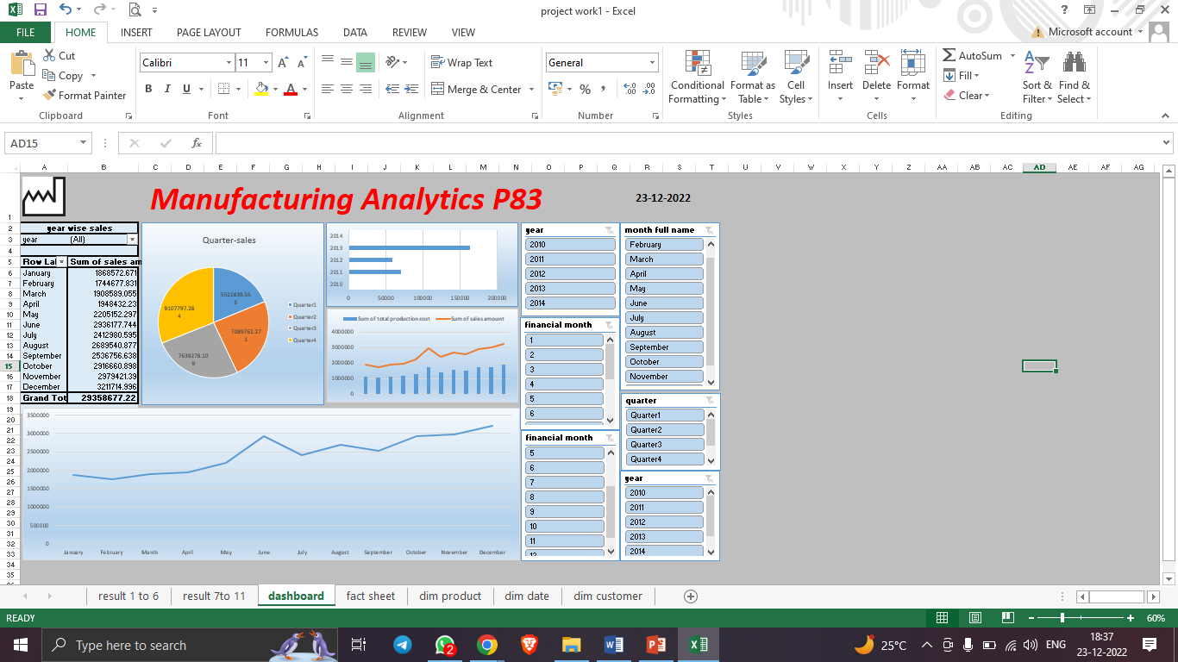
Dashboard:

Slide 6
SQL- TASK 1- By pushkar Angal ( EMPLOYEE TABLE AND DEPT TABLE)
STATEMENTS USED:
DDL – CREATE
DML – INSERT
DQL - SELECT
AGGREGATE FUNCTIONS – MAX, COUNT, SUM
WINDOW FUNCTIONS – RANK
JOINS – LEFT JOIN, INNER JOIN
GROUP BY STATEMENTS, ORDER BY

Slide 7
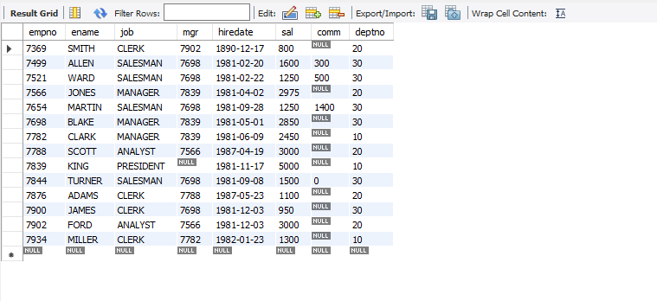
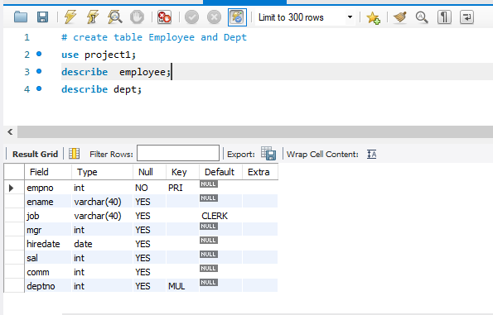

Slide 8
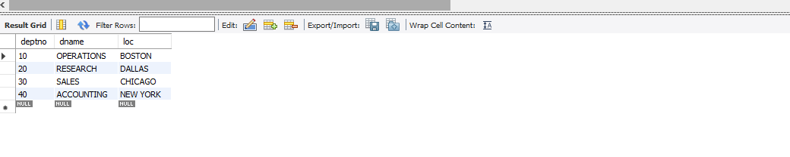
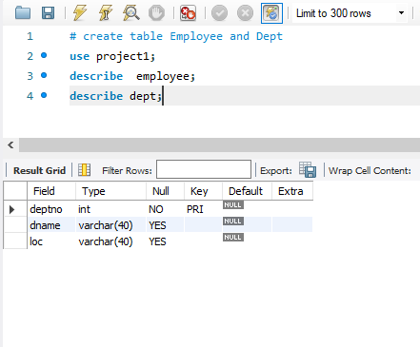

Slide 9
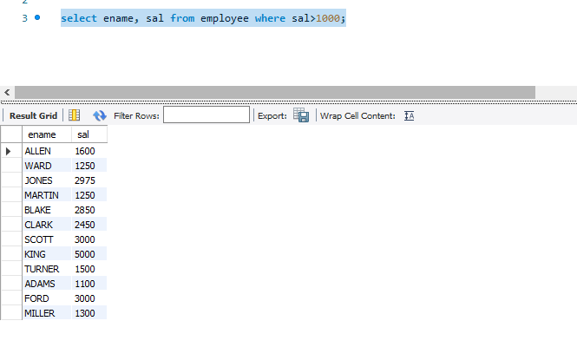

Slide 10
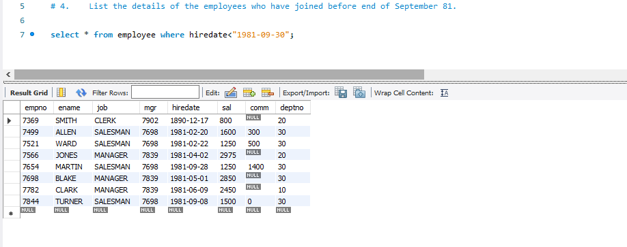

Slide 11
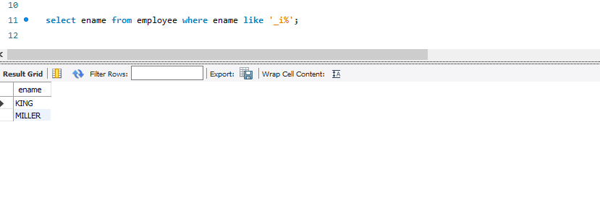

Slide 12
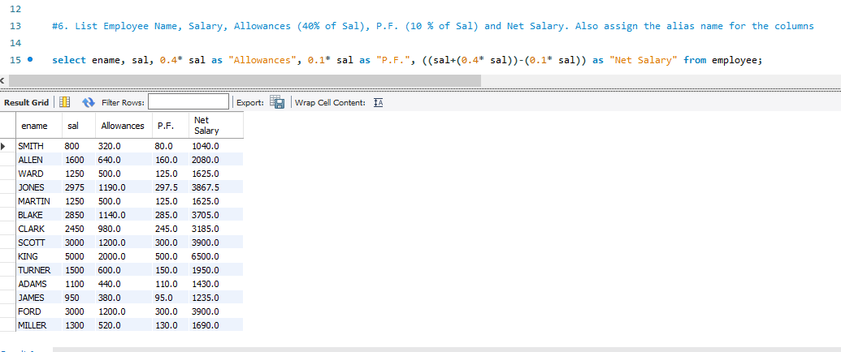

Slide 13
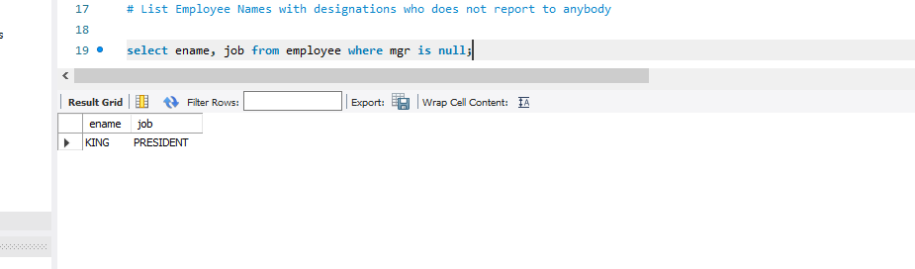

Slide 14
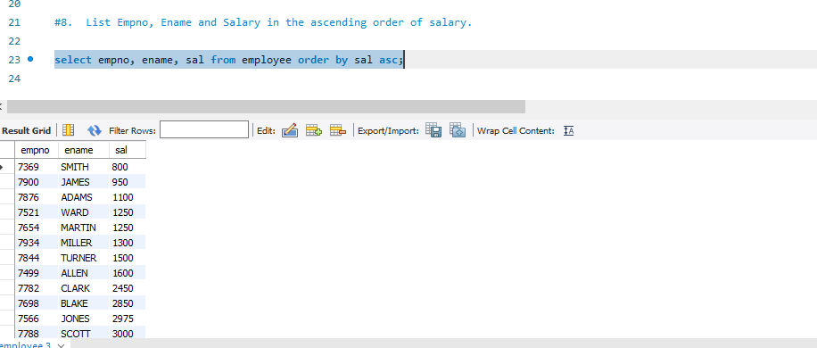

Slide 15
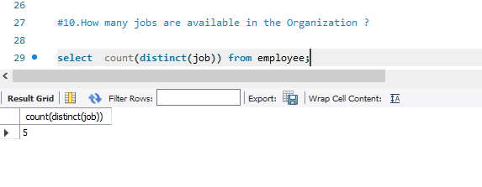

Slide 16
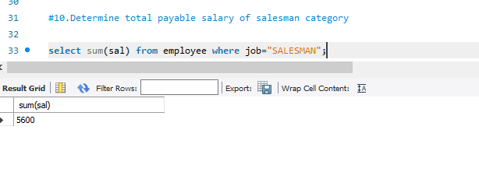

Slide 17
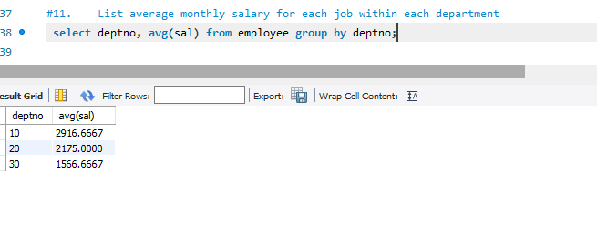

Slide 18
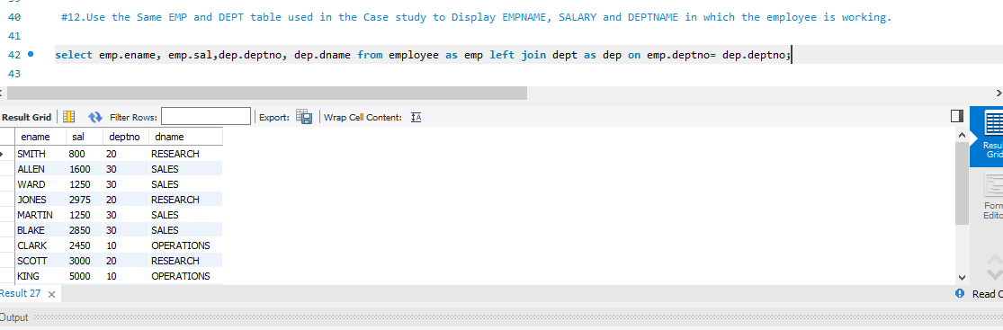

Slide 19
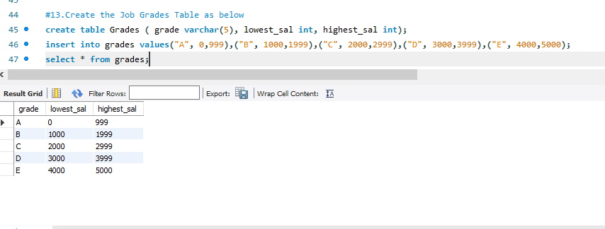

Slide 20
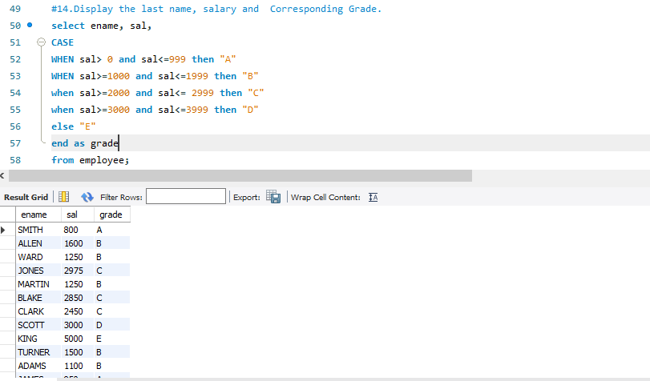

Slide 21
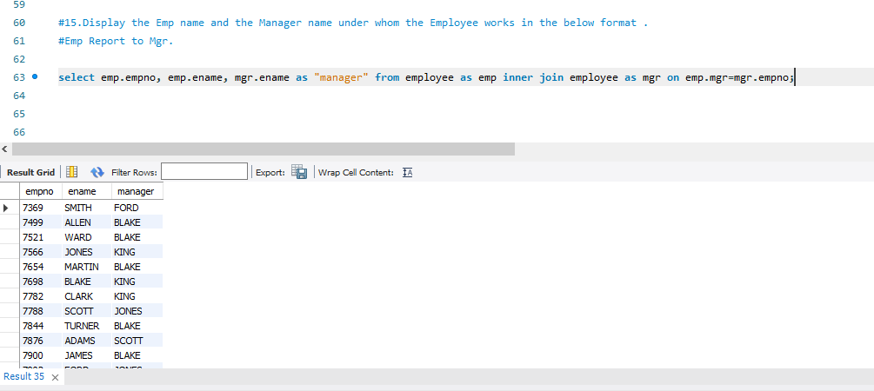

Slide 22
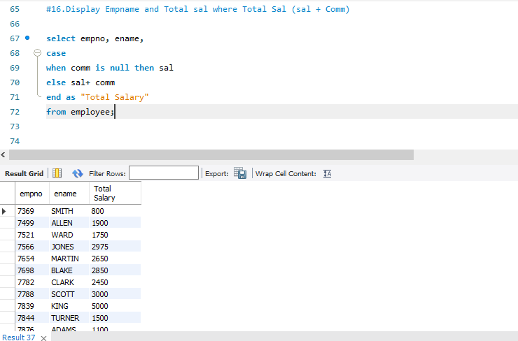

Slide 23
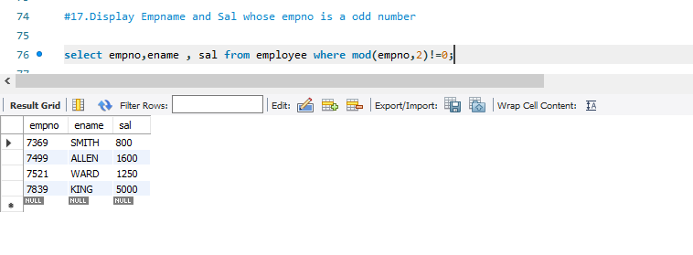

Slide 24
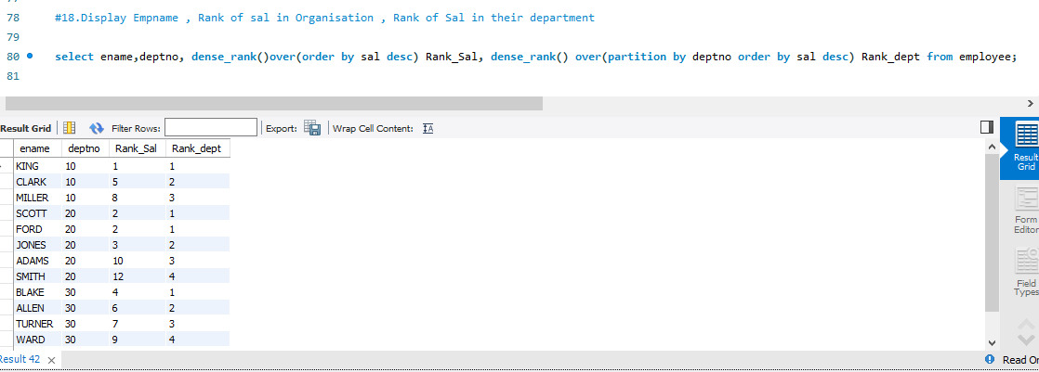

Slide 25
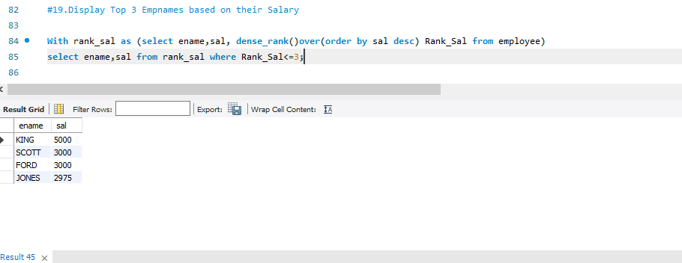

Slide 26
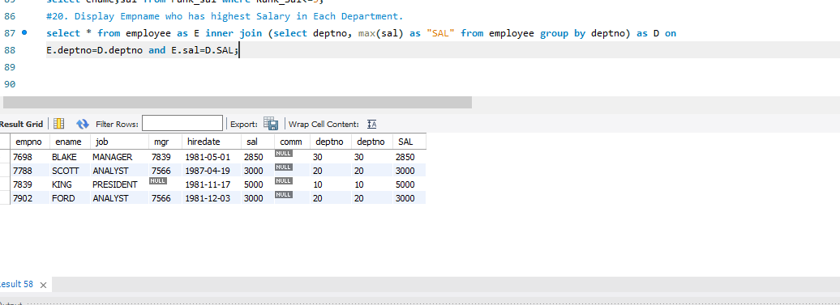

Slide 27
Power BI Dashboard
Data modelling and DAX- by Ajay Nimbalkar
Charts and Dashboard by Guru Prashant

Slide 28
Data modelling and dax
Data Modeling is one of the features used to connect multiple data sources in BI tool using a relationship. A relationship defines how data sources are connected with each other and you can create interesting data visualizations on multiple data sources.
With the modeling feature, you can build custom calculations on the existing tables and these columns can be directly presented into Power BI visualizations. This allows businesses to define new metrics and to perform custom calculations for those metrics.

Slide 29
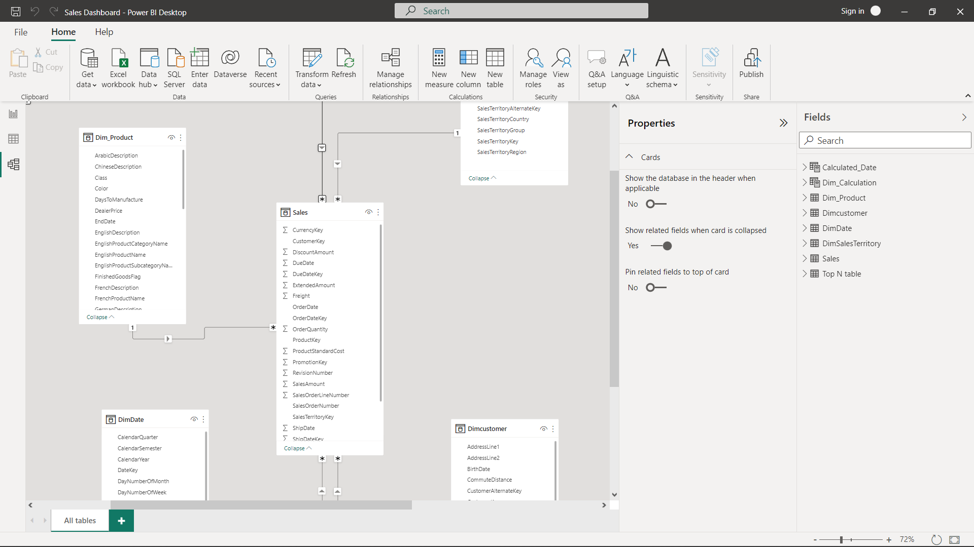
In the above image, you can see a common data model,
which shows a relationship between the tables.
In Power BI, you set the relationship between two objects.
To set the relationship, you have to drag a line between the
common columns. You can also view the “Relationship” in a
data model in Power BI
To create data model in Power BI, you need to add all data
sources in Power BI new report option. To add a data source,
go to the Get data option. Then, select the data source you
want to connect and click the Connect button.
Here the relationship between the columns is many to one.

Slide 30
DAX
DAX (Data Analysis Expressions) is a formula expression language and can be used in different BI and visualization tools. DAX is also known as function language, where the full code is kept inside a function.
DAX programming formula contains two data types: Numeric and Other. Numeric includes - integers, currency and decimals, while Other includes: string and binary object.

Slide 31
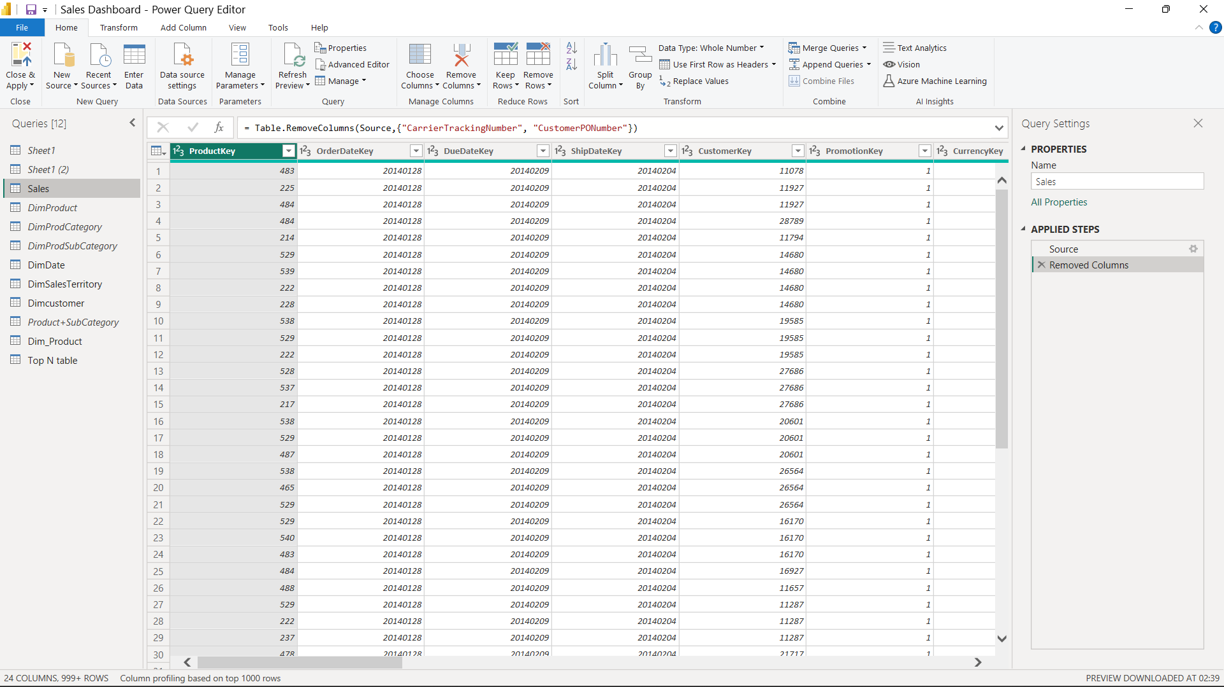
This is the example of using Dax Expression to remove the unnecessary columns in a table.
DAX Functions
In Power BI, you can use different function types to analyze data, and create new columns and measures. It includes functions from different categories such as −
Aggregate
Text
Date
Logical
Counting
Information

Slide 32
Power bi charts and dashboard
Charts Created:
Combinational Chart
Line Chart
Donut Chart
Crosstab
Bar Chart with Dynamic_Measure
Top N Chart
Funnel Chart
Bump Chart
Sales Dashboard with KPIs

Slide 33
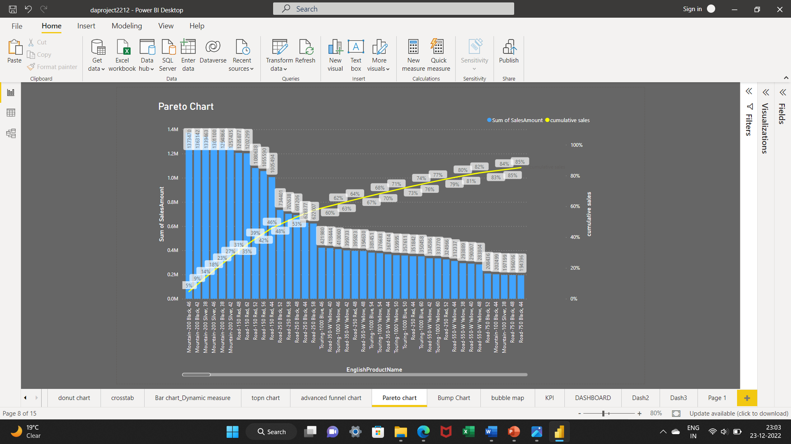
Pareto chart

Slide 34
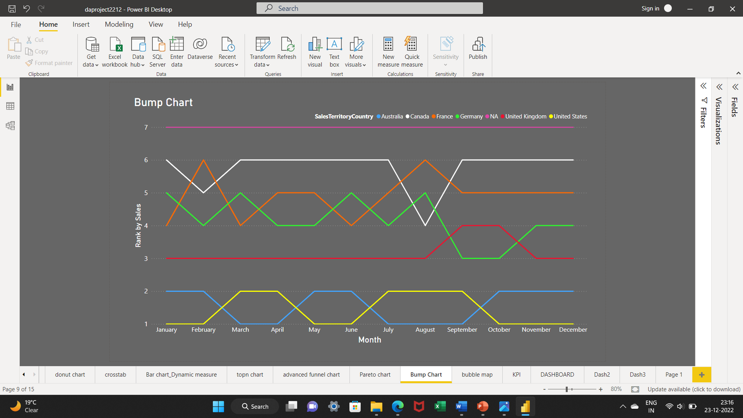
Bump chart

Slide 35
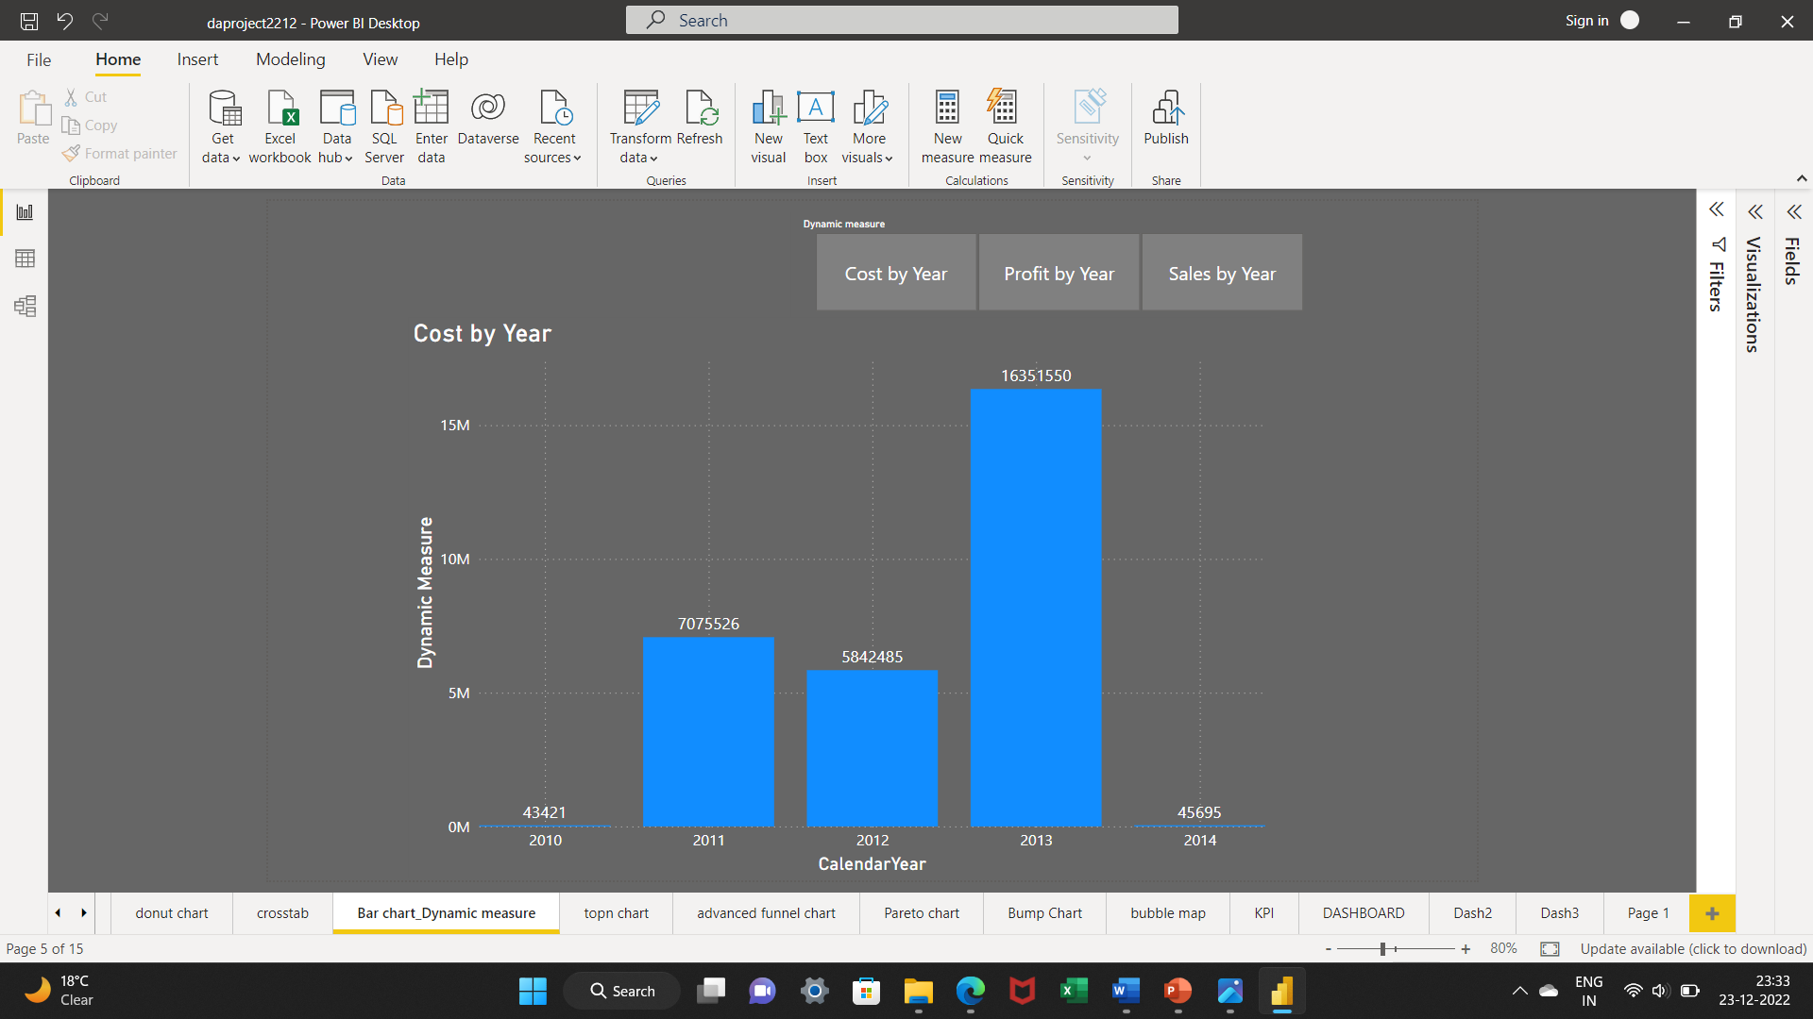
BAR CHART WITH DYNAMIC MEASURE

Slide 36
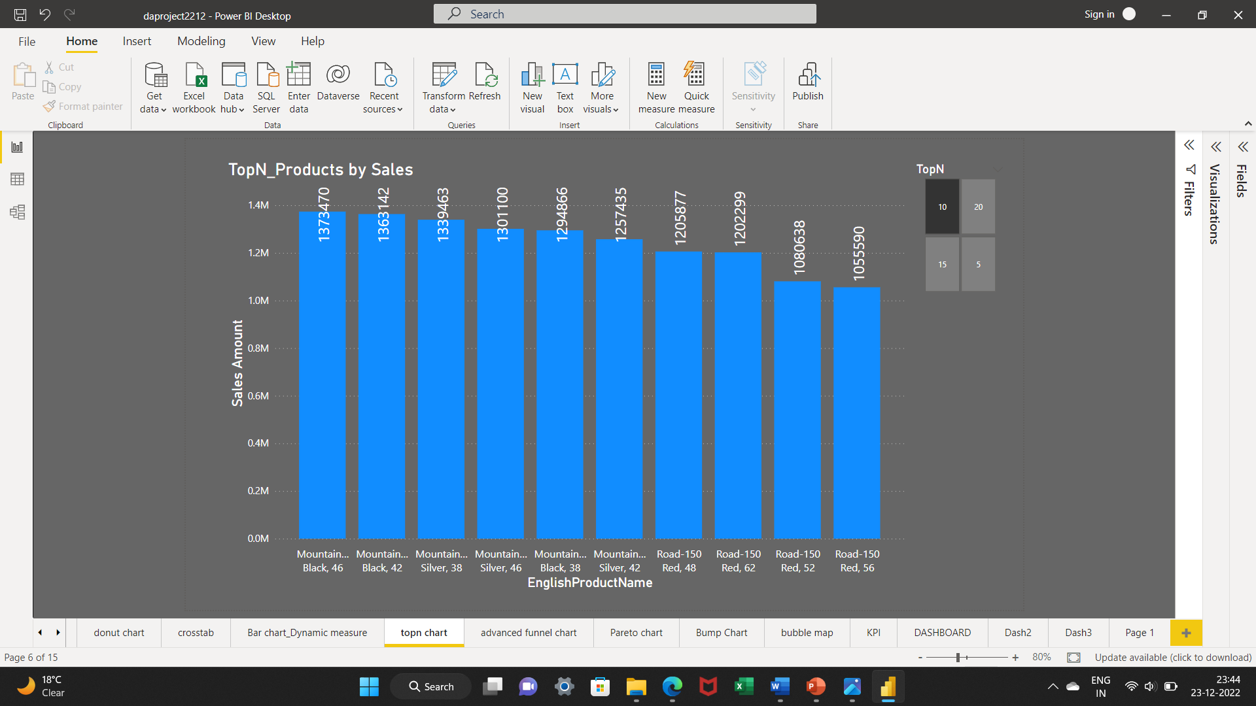
Top_n chart

Slide 37
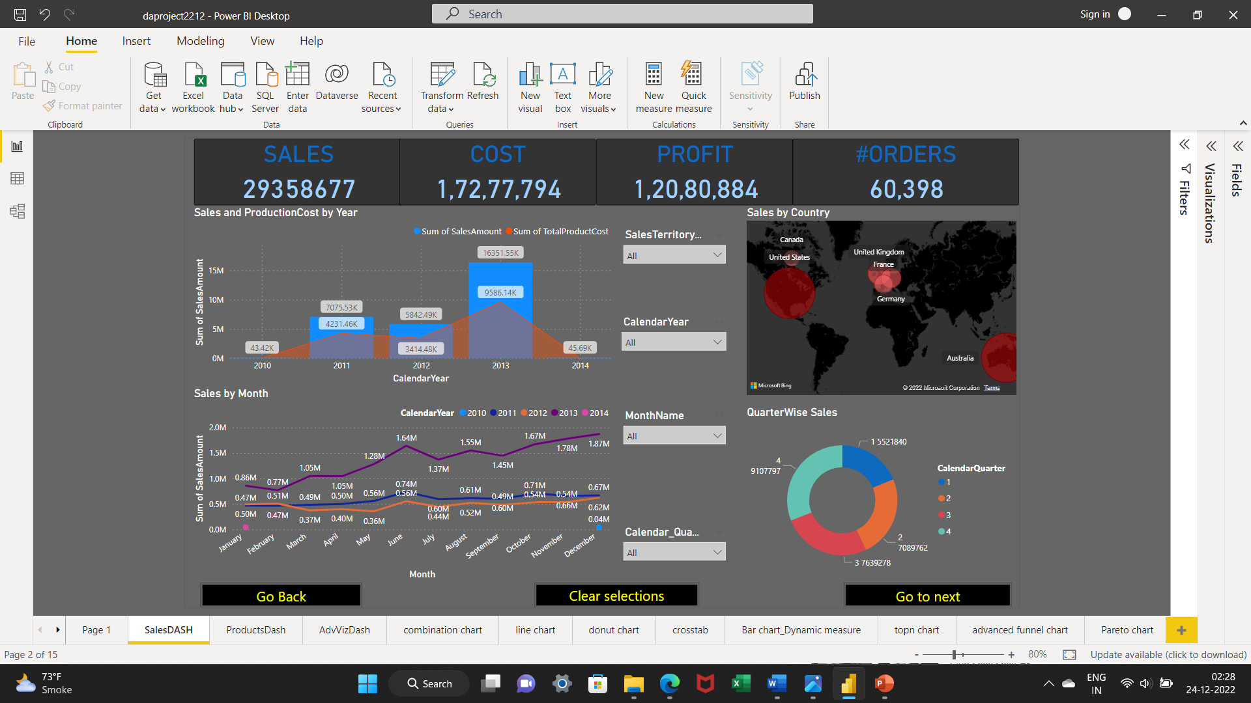
Sales Dashboard

Slide 38
Thank you!

